Slide 1
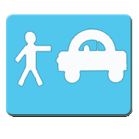

Finding Ride App
Itay Ariel

Slide 2
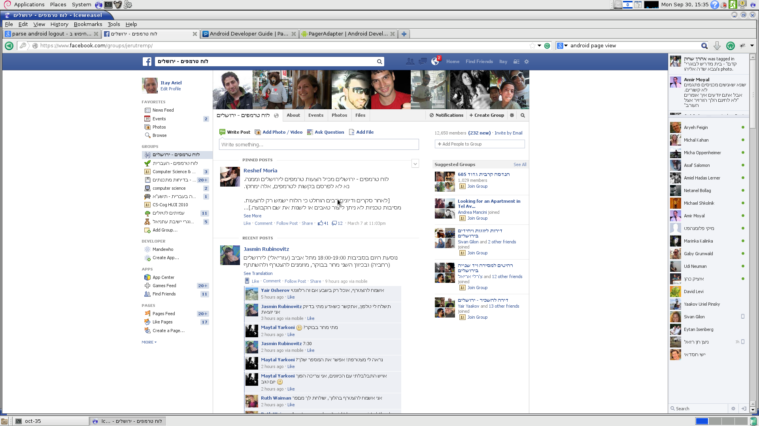
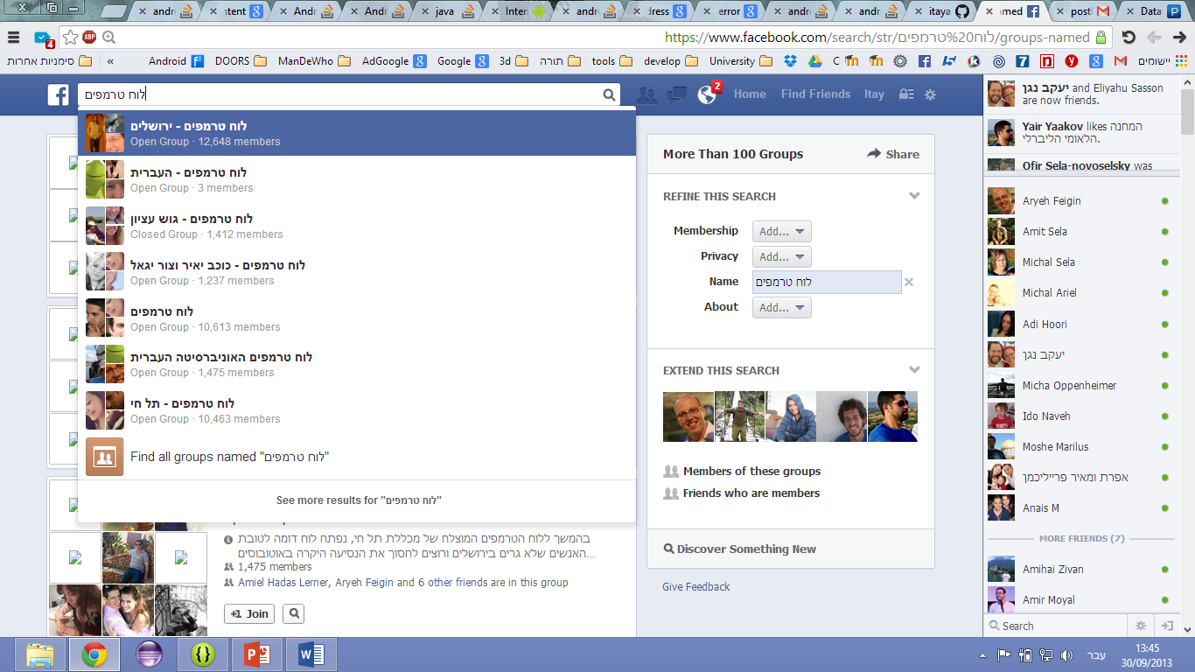
App Concept

Slide 3
App Concept
Fast login – with one click
Options to offer or ask for rides
Live information immediately after login – everything in front of the eyes
Ability to restrict viewing and publishing only to specific groups
Fast communication using other phone apps

Slide 4
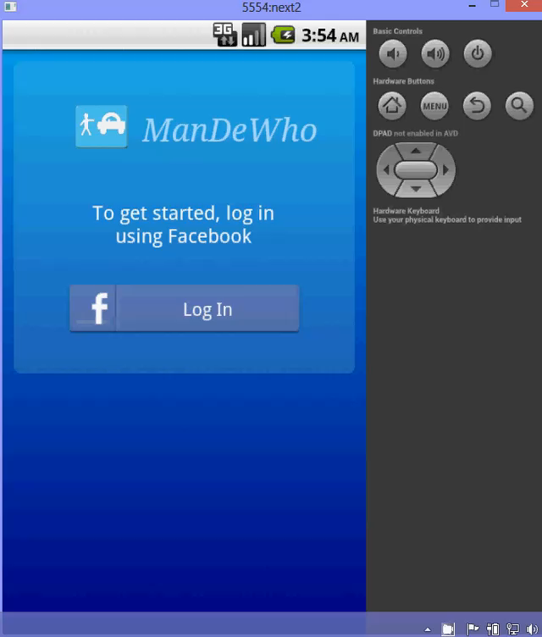
Demo

Slide 5
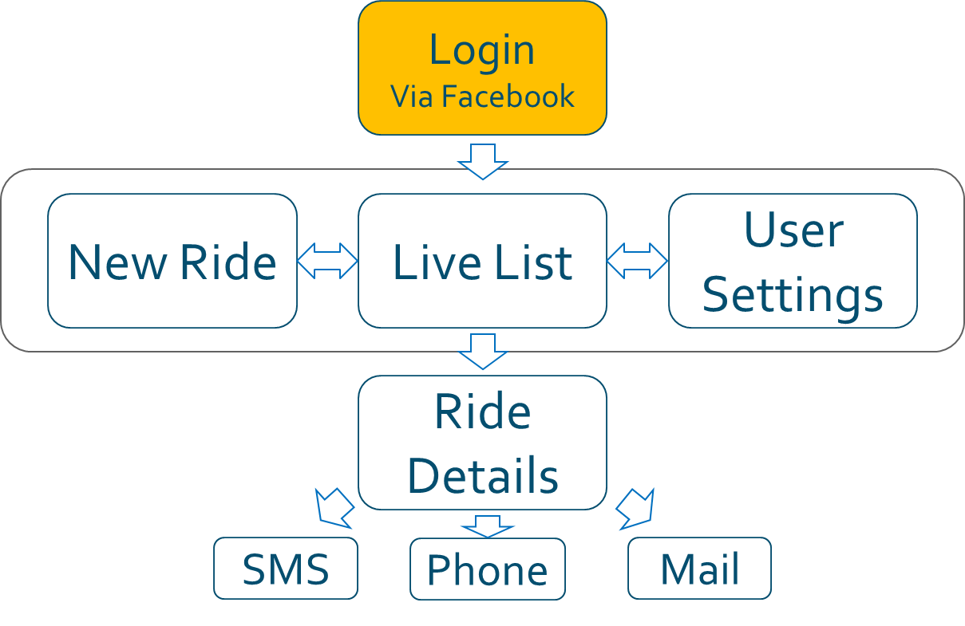
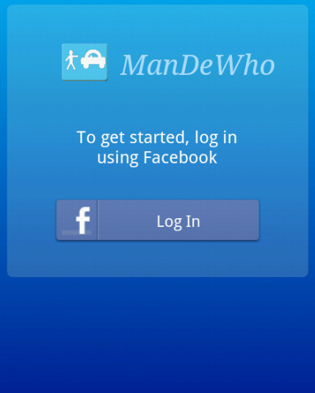
Architecture
Login Activity uses the Facebook SDK for login.
If the user has the Facebook app on his phone, login is done with one click.

Slide 6
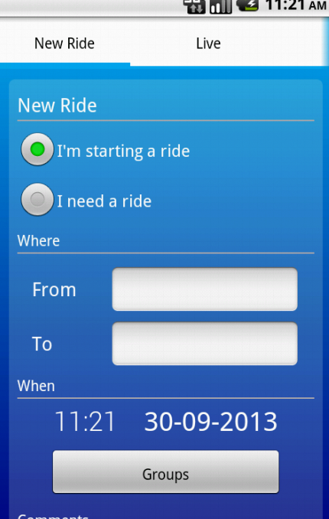
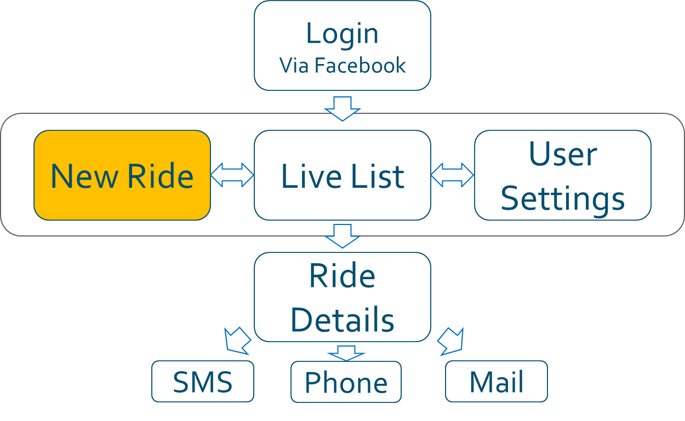
Architecture
Main Activity has three fragments:
New Ride
Live List
User Settings
Viewed via Fragment pager adapter

Slide 7
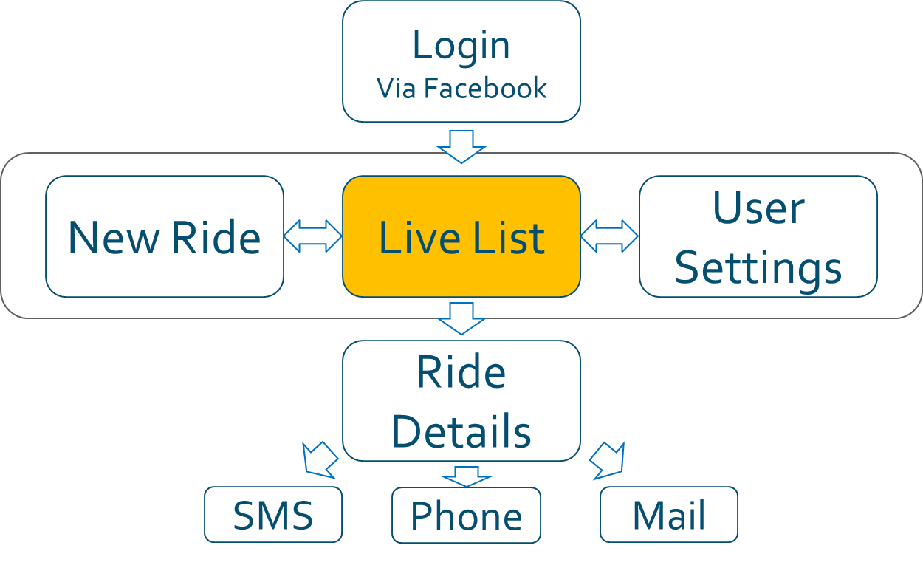
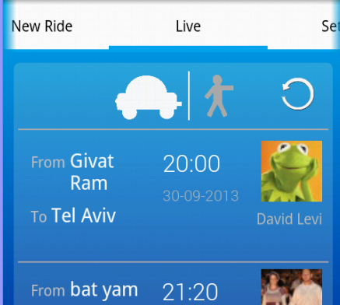
Architecture
Live List
Switch between rides and riders
Query on demand.

Slide 8
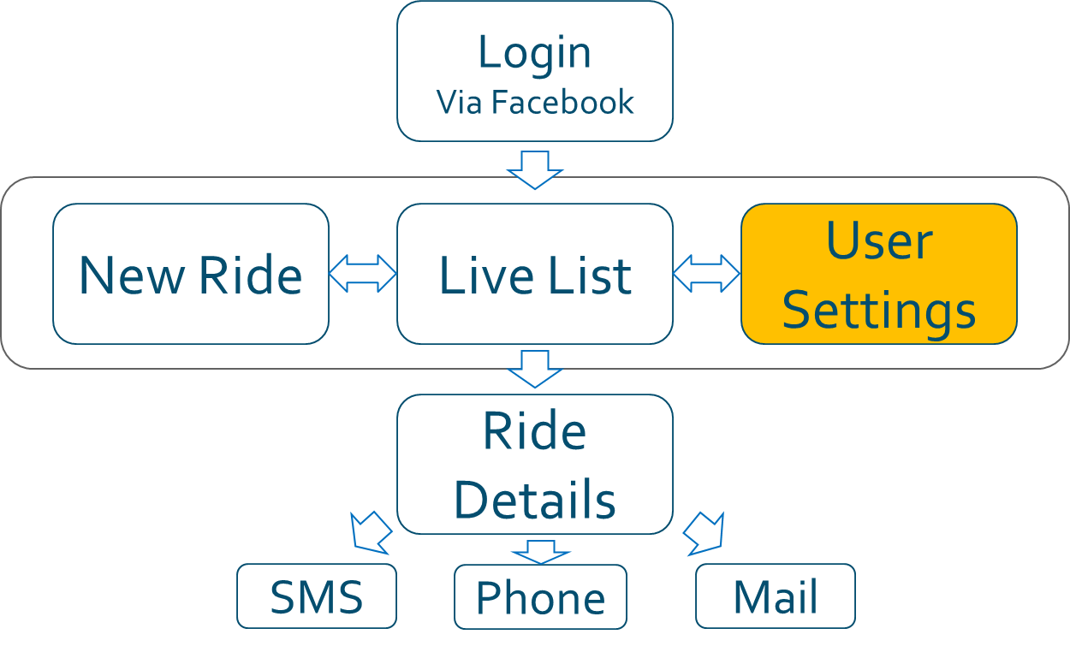
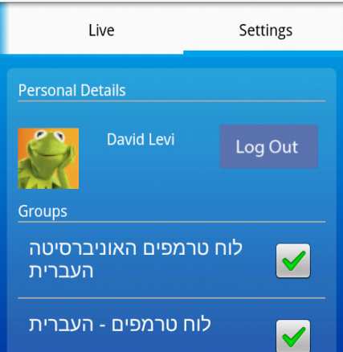
Architecture
Settings
User can choose which Facebook groups he wants to use.

Slide 9
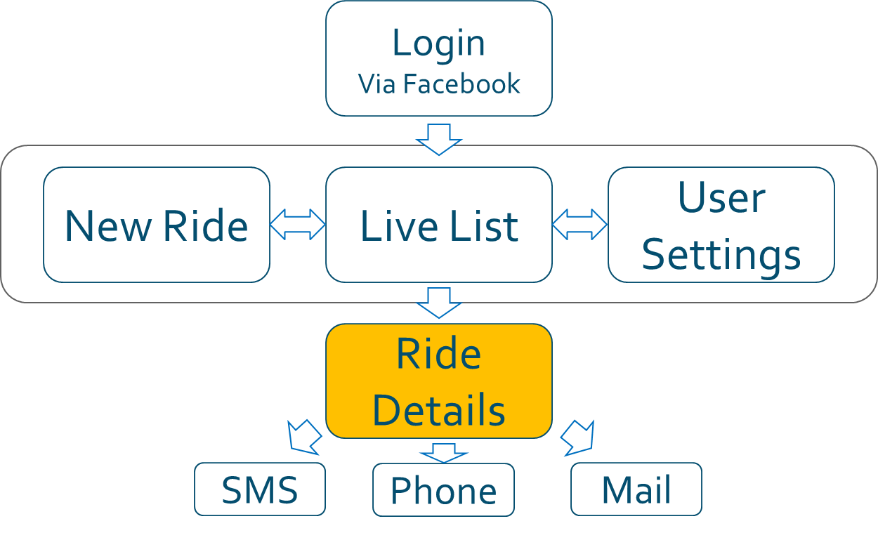
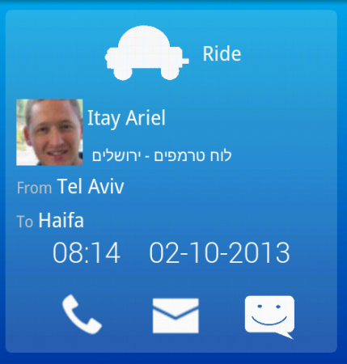
Architecture
Ride Activity
User can start an intent for SMS, Mail or Phone call

Slide 10
Architecture
Facebook connection
The app queries from Facebook the following information:
User Facebook ID
User full name.
Email
Picture
List of Groups
The information is updated each time the user opens the App.
Parse Cloud
Facebook
Client side App

Slide 11
Architecture
Parse connection
The app uses Parse for the following
Storing each user information and settings.
Storing all rides.
Querying rides for each user according to his own groups.
All connections to server are done in an async way.
Parse Cloud
Facebook
Client side App

Slide 12
Thank you!
Any question?

